Slide 1


Student Success Scorecard:
2018 Report
Presentation to the
West Valley Mission Community College District Board of Trustees
February 19, 2019
Inge Bond, Mission College
Miqueas Dial, West Valley College
Notes:
Introductions: both

Slide 2

Student Success Scorecard
Annual statewide report providing system- and college-level analyses of core descriptive and performance indicators
The report is used for information and understanding; it is not tied to any funding at the system or college level
http://scorecard.cccco.edu

Slide 3
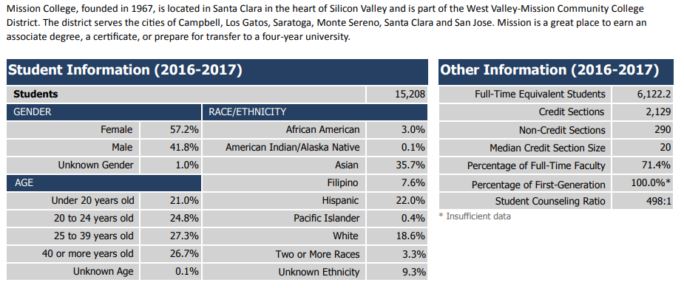
Mission College Profile
Notes:
Based on credit and non-credit headcount across all 4 terms. Students attending multiple terms counted only once. Students attending more than one CCC during the year are counted once at each college.
FTES is credit and non-credit, CA resident only. Represents 525 hours of student instruction.
First generation student data requested in Open CCC Apply, but not being imported into Banner for 2016-2017

Slide 4
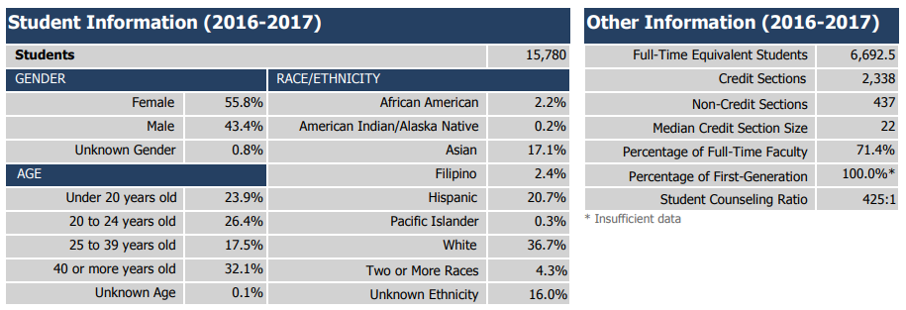
West Valley College Profile
Notes:
Based on credit and non-credit headcount across all 4 terms. Students attending multiple terms counted only once. Students attending more than one CCC during the year are counted once at each college.
FTES is credit and non-credit, CA resident only. Represents 525 hours of student instruction.
First generation student data requested in Open CCC Apply, but not being imported into Banner for 2016-2017

Slide 5
Scorecard Metrics: Caveats and Notes
Metrics are cohort based, so only students demonstrating certain behaviors are included, often a small percentage of the college’s student body
Math, English, and ESL metrics do not count sequence progression short of gatekeeper (college-level) course completion
Rates are recalculated each year with updated data and definitions so prior year reports should be disregarded
Metric data reported in disaggregated and five-year form here: http://scorecard.cccco.edu

Slide 6
Visualizing Six-Year Cohorts
(cohort: a group of individuals having a statistical factor in common in a demographic study)
2007-08 | 2008-09 | 2009-10 | 2010-11 | 2011-12 | 2012-13 | 2013-14 | 2014-15 | 2015-16 | 2016-17
START |  |  |  |  | END
 | START |  |  |  |  | END
 |  | START |  |  |  |  | END
 |  |  | START |  |  |  |  | END
 |  |  |  | START |  |  |  |  | END
Notes:
Inge

Slide 7
Remedial ESL
Remedial ESL: percentage of credit students tracked for six years who started any levels below transfer level in ESL and completed a college-level course in ESL or English
Notes:
Inge

Slide 8
Remedial ESL
2011-12 to 2016-17 Cohort
 | MC | WVC
ESL to College Level | 16.3% | 22.9%
Number in Cohort
Year | MC | WVC
2007-2008 | 599 | 214
2008-2009 | 692 | 227
2009-2010 | 615 | 225
2010-2011 | 576 | 224
2011-2012 | 583 | 179

Slide 9
Remedial English
Remedial English: percentage of credit students tracked for six years who started 1 to 4 levels below transfer in English and completed a college-level course in that discipline
Notes:
Inge

Slide 10
Remedial English
2011-12 to 2016-17 Cohort
 | MC | WVC
Remedial English to College Level | 52.7% | 56.4%
Number in Cohort
Year | MC | WVC
2007-2008 | 777 | 676
2008-2009 | 882 | 647
2009-2010 | 980 | 789
2010-2011 | 918 | 848
2011-2012 | 916 | 917

Slide 11
Remedial Math
Remedial Math: percentage of credit students tracked for six years who started 2 to 4 levels below transfer level in Math and completed a college-level course in that discipline
Notes:
Inge

Slide 12
Remedial Math
2011-12 to 2016-17 Cohort
 | MC | WVC
Remedial Math to College Level | 36.7% | 46.7%
Number in Cohort
Year | MC | WVC
2007-2008 | 472 | 760
2008-2009 | 515 | 822
2009-2010 | 1,184 | 878
2010-2011 | 976 | 876
2011-2012 | 1,012 | 863

Slide 13
English and Math Transfer Levels – 1 Year
English:
The percentage of first-time students who successfully complete transfer level English in their first year
Math:
The percentage of first-time students who successfully complete transfer level math in their first year

Slide 14
English Transfer Level: 1 Year
2015-16 Cohort of First-time Students
 | MC | WVC
English Transfer Level 1 Yr | 57.4% | 57.2%
Number in Cohort
Year | MC | WVC
2011-2012 | 610 | 895
2012-2013 | 521 | 934
2013-2014 | 575 | 953
2014-2015 | 521 | 874
2015-2016 | 605 | 871

Slide 15
Math Transfer Level: 1 Year
2015-16 Cohort of First-time Students
 | MC | WVC
Math Transfer Level 1 Yr | 21.5% | 30.9%
Number in Cohort
Year | MC | WVC
2011-2012 | 610 | 895
2012-2013 | 521 | 934
2013-2014 | 575 | 953
2014-2015 | 521 | 874
2015-2016 | 605 | 871

Slide 16
Levels of Preparation
Overall: Student attempted any level of Math or English in the first three years
College Prepared: Student’s lowest course attempted in Math and/or English was college level
Unprepared for College: Student’s lowest course attempted in Math and/or English was remedial level
Notes:
For this presentation we will look at single-year disaggregation by level of preparation, and at non-disaggregated trend data.
Please note that 5 years of data, disaggregated both by trend and by demographics (ethnicity, age, and gender) can be found at: http://scorecard.cccco.edu

Slide 17
Completion Rate
Completion Rate: Percentage of first-time degree and/or transfer-seeking students tracked for six years who completed a degree, certificate, or transfer-related outcome
Notes:
Definition: The percentage of first-time students with a minimum of 6 units earned who attempted any Math or English in the first three years and achieved any of the following within six years of entry: earned AA/AS or CCCCO approved credit Certificate; transfer to a four-year institution; achieved transfer-prepared – student successfully completed 60 UC/CSU transferable units with a GPA >= 2.0

Slide 18
Completion: Overall
Completion Rate: 2011-12 to 2016-17 Cohort
 | MC | WVC
Overall | 50.3% | 60.9%
College Prepared | 77.0% | 79.1%
Unprepared for College | 41.6% | 49.8%
Number in Cohort
Year | MC | WVC
2007-2008 | 933 | 1,089
2008-2009 | 1,064 | 1,434
2009-2010 | 1,050 | 1,230
2010-2011 | 1,060 | 1,298
2011-2012 | 1,044 | 1,230

Slide 19
Completion: Peer Group
Berkeley City | 45.0%
Canada | 52.8%
Foothill | 60.4%
Irvine Valley | 62.8%
Marin | 51.3%
Mission | 50.3%
Saddleback | 58.2%
San Diego Miramar | 56.4%
San Francisco City | 53.0%
San Mateo | 56.4%
West Valley | 60.9%
Average | 55.2%
Notes:
Both colleges in same peer group for completion.
List of school identified as being in our peer group on the Completion metric
Explain external variables that lead to peer grouping: Predictors are Academic Performance Index (calculated by the DOE for each school based on standardized test scores – weighted API assigned to each college based on the proportion of enrolled students from a given high school); BA Index ( bachelor degree attainments of the population 25 years or older in the college’s service area); Pct Age 25+ (the percentage of students at a community college in the Fall of 2010 that are age 25 or older)

Slide 20
Completion: Peer Group Data
2011-2012 Cohort | Mission College Completion Peer Group Comparison
 | Mission | Peer Low | Peer High | Peer Avg
Completion Rate | 50.3% | 45.0% | 62.8% | 55.2%
2011-2012 Cohort | West Valley College Completion Peer Group Comparison
 | WVC | Peer Low | Peer High | Peer Avg
Completion Rate | 60.9% | 45.0% | 62.8% | 55.2%

Slide 21
Persistence
Persistence: Percentage of degree- and/or transfer-seeking students tracked for six years who attempted any level of Math or English in the first three years and enrolled in the first three consecutive primary terms anywhere in the CCC system
Notes:
Same as the Completion cohort
This metric is considered a milestone or momentum point, research shows that students with continuous enrollment are more likely to succeed.
Definition: The percentage of first-time students with minimum of 6 units earned who attempted any math or English in the first three years and achieved the following measure of progress: enrolled in first three consecutive primary semester terms anywhere in the CCC system; persisted by attempting a credit course in the first three primary semester terms OR completion of any of the following within the first three primary semester terms: AA/AS, Credit Certificate, Transfer)

Slide 22
Persistence: Overall
Persistence: 2011-12 to 2016-17 Cohort
 | MC | WVC
Overall | 73.2% | 81.6%
College Prepared | 63.8% | 82.2%
Unprepared for College | 76.2% | 81.3%
Number in Cohort
Year | MC | WVC
2007-2008 | 933 | 1,089
2008-2009 | 1,064 | 1,434
2009-2010 | 1,050 | 1,230
2010-2011 | 1,060 | 1,298
2011-2012 | 1,044 | 1,230

Slide 23
30 Units
30 Units: Percentage of first-time students with a minimum of 6 units who attempted any level of Math or English and who earned at least 30 units within 6 years.
Notes:
ENROLLMENT-UNITS-EARNED >= 6 at your college and/or anywhere in the CCC system during first three years of enrollment. Units earned include completed courses with a grade of A, B, C, D or P.

Slide 24
30 Units: Overall
30 Units: 2011-12 to 2016-17 Cohort
 | MC | WVC
Overall | 71.3% | 74.1%
College Prepared | 65.4% | 69.7%
Unprepared for College | 73.2% | 76.7%
Number in Cohort
Year | MC | WVC
2007-2008 | 933 | 1,089
2008-2009 | 1,064 | 1,434
2009-2010 | 1,050 | 1,230
2010-2011 | 1,060 | 1,298
2011-2012 | 1,044 | 1,230

Slide 25
Career Technical Education Completion
Career Technical Education: percentage of students tracked for six years who completed more than 8 units in courses classified as career technical education (vocational) in a single discipline and completed a degree, certificate, transfer-related or apprenticeship outcome.
Notes:
State does not disaggregate this metric by level of preparation

Slide 26
Career Technical Education
2011-12 to 2016-17 Cohort
 | MC | WVC
CTE Completion | 53.3% | 52.1%
Number in Cohort
Year | MC | WVC
2007-2008 | 1,091 | 1,019
2008-2009 | 1,127 | 1,090
2009-2010 | 1,115 | 1,154
2010-2011 | 993 | 1,058
2011-2012 | 941 | 984

Slide 27
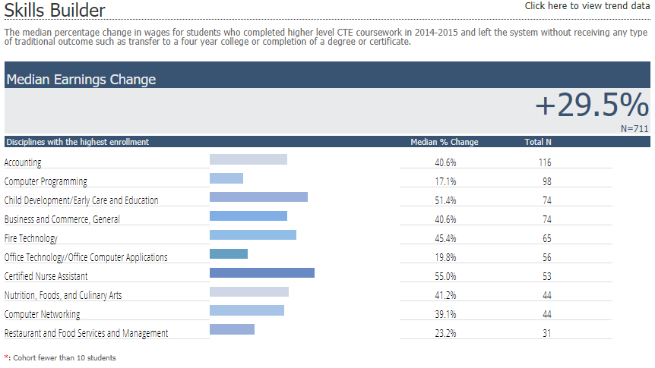
Mission College: Skills Builder
Notes:
Intent of this metric is the quantify the impact of coursework/training for students in CTE areas who don’t attain a traditional “completion”. In Child Development, for example, students attained quite a significant wage gain even without walking away with a degree or certificate.
The measurement is the median percent change in wages for these students from one year before the academic year of enrollment to one year after leaving the system.

Slide 28
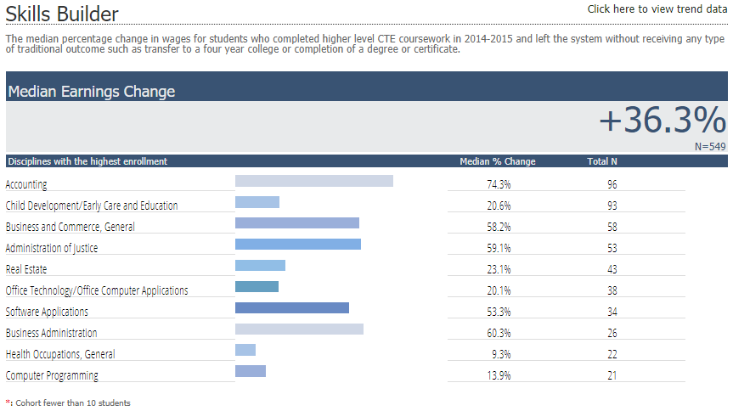
West Valley College: Skills Builder
Notes:
Intent of this metric is the quantify the impact of coursework/training for students in CTE areas who don’t attain a traditional “completion”.
The measurement is the median percent change in wages for these students from one year before the academic year of enrollment to one year after leaving the system.

Slide 29
Coming Attraction:
Student Success Metrics
Focus is on student journeys:
  Recruitment to completion, transfer, and the workforce
  Student groups:
    Adult Ed/ESL students
    Short-Term Career Ed Students
    Degree/Transfer Students
    Undecided/Other Students

Slide 30
Student Success Metrics: A Sampling
Successful Enrollment
Successful Completion of Unit Thresholds
Retained From Fall To Spring
Transferred to a Four-Year Institution
Average Number of Units Accumulated by Associate Degree Earners
Median Change in Earnings
Notes:
Inge
Successful Enrollment: among all applicants, proportion who enrolled in a community college in the selected year
Successful Completion of Unit Thresholds: 12+ in Fall; 24+ for whole year
Median Change in Earnings: among all students who did not transfer, the median change in earnings between the second quarter prior to the beginning of the academic year of entry and the second quarter after the end of the academic year of exit from the last college attended

Slide 31
Discussion, Questions
Notes:
Miqueas

Slide 32
Thank you for your time and your interest!
Notes:
both

